Slide 1


Computer Organization and Architecture
Div C SY COMP
Sem III
Snehal
AY 2024-25

Slide 2


Computer Organization and Architecture
Course Outcomes
At the end of successful completion of the course the student will be able to
CO 1. Describe and define the structure of a computer with buses structure and detail working of the arithmetic logic unit and its sub modules
CO 2. Understand the Central processing unit with addressing modes and
working of control unit in depth
CO 3. Learn and evaluate memory organization and cache structure
CO 4. Summarize Input output techniques and multiprocessor
configurations

Slide 3
Module 1
Structure of a Computer System
1.1
Introduction of computer system and its sub modules, Basic organization of computer and block level description of the functional units. Von Neumann model 1.2
Introduction to buses, bus types, and connection I/O devices to CPU and memory, PCI and SCSI

Slide 4
Computer Evolution and Performance
Generations of Computer
Vacuum tube - 1946-1957
Transistor - 1958-1964
Small scale integration - 1965 – Up to 100 devices on a chip
Medium scale integration - to 1971 – 100-3,000 devices on a chip
Large scale integration - 1971-1977 – 3,000 - 100,000 devices on a chip
Very large scale integration - 1978 -1991 – 100,000 - 100,000,000 devices on a chip
Ultra large scale integration – 1991 -Over 100,000,000 devices on a chip
2020- 2.6 Trillion devices on chip ( 1 trillion = 10^12)

Slide 5
Computer Evolution and Performance
Von Neumann
Stored Program concept
Main memory storing programs and data
ALU operations on binary data
Control unit interpreting instructions from memory and executing
Input and output equipment operated by control unit
Princeton Institute for Advanced Studies – IAS
Completed 1952

Slide 6
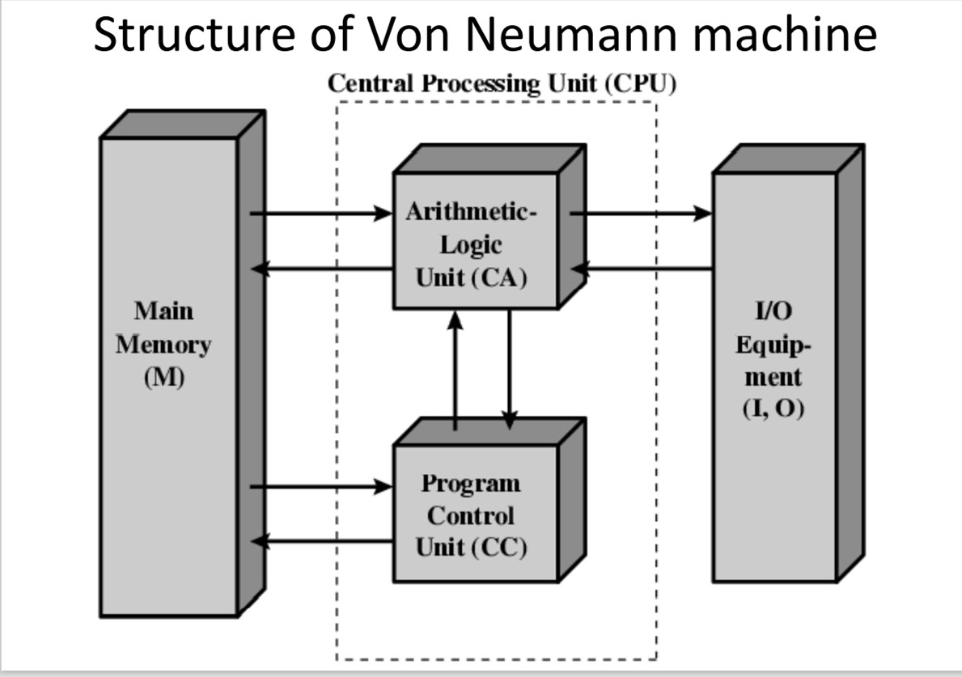
Computer Evolution and Performance

Slide 7
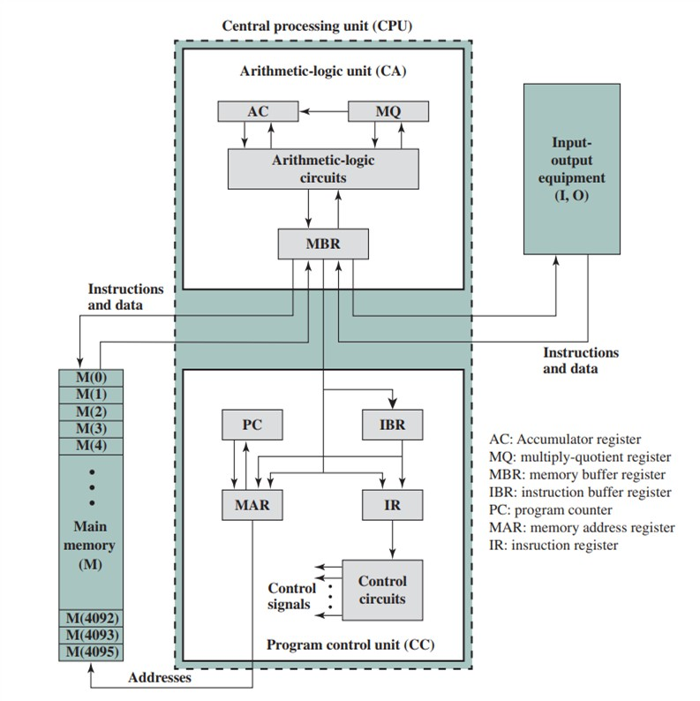
Structure of IAS

Slide 8
IAS Registers
Memory buffer register (MBR): Contains a word to be stored in memory or sent
to the I/O unit, or is used to receive a word from memory or from the I/O unit.
Memory address register (MAR): Specifies the address in memory of the word to be written from or read into the MBR.
Instruction register (IR): Contains the 8-bit opcode instruction being executed.
Instruction buffer register (IBR): Employed to hold temporarily the right hand instruction from a word in memory.
Program counter (PC): Contains the address of the next instruction pair to be
fetched from memory.
Accumulator (AC) and multiplier quotient (MQ): Employed to hold temporarily operands and results of ALU operations.

Slide 9
Operations in IAS
Data transfer: Move data between memory and ALU registers or between two ALU registers.
Unconditional branch: Normally, the control unit executes instructions in sequence from memory. This sequence can be changed by a branch instruction, which facilitates repetitive operations.
Conditional branch: The branch can be made dependent on a condition, thus allowing decision points.
Arithmetic: Operations performed by the ALU.
Address modify: Permits addresses to be computed in the ALU and then inserted into instructions stored in memory. This allows a program considerable addressing flexibility.

Slide 10
Computer Evolution and Performance
Harvard Architecture
VLSI technology Developments : Moore’s Law
Which is the smallest element?
Concept of family of processors
Similar or identical instruction set:
Similar or identical operating system:
Increasing speed:
Increasing number of I/O ports:
Increasing memory size:
Increasing cost:

Slide 11
Computer Evolution and Performance
Which companies for microprocessors ?
Are embedded systems a computer?
RISC and CISC ?

